Slide 1
Collaborative filtering algorithm implementation Using Probabilistic Matrix Factorization and Large-scale Parallel Collaborative Filtering using SVD with KNN
Project by: Yanan Li, Daniel Weiss, Bingquan Wu,
Shijie Zhang, and Na Zhuo

Slide 2
Background
Companies are increasingly using advanced recommendation systems to recommend products to customers
In October 2006, Netflix released user and movie data under a challenge to improve upon their content filtering algorithm
Netflix uses collaborative filtering, in which all user ratings are used to predict which content items would appeal to similar users
Companies need fast, efficient algorithms to process these enormous amounts of data and accommodate users with few ratings
This is done with Latent Factoring that characterizes users and items based on machine inferred factors. These factors are created by rating patterns. This means user and item attributes may be automatically generated

Slide 3
Probabilistic Matrix Factorization (PMF)
Assume gaussian distributions of ratings for users and movies
Benefits:
PMF scales linearly with the number of observations
Performs well on sparse and imbalanced datasets
Models the user preference matrix as a product of two lower-rank user and movie matrices
Original study found an error rate of 88.61%, almost 7% improvement over Netflix’s algorithm

Slide 4
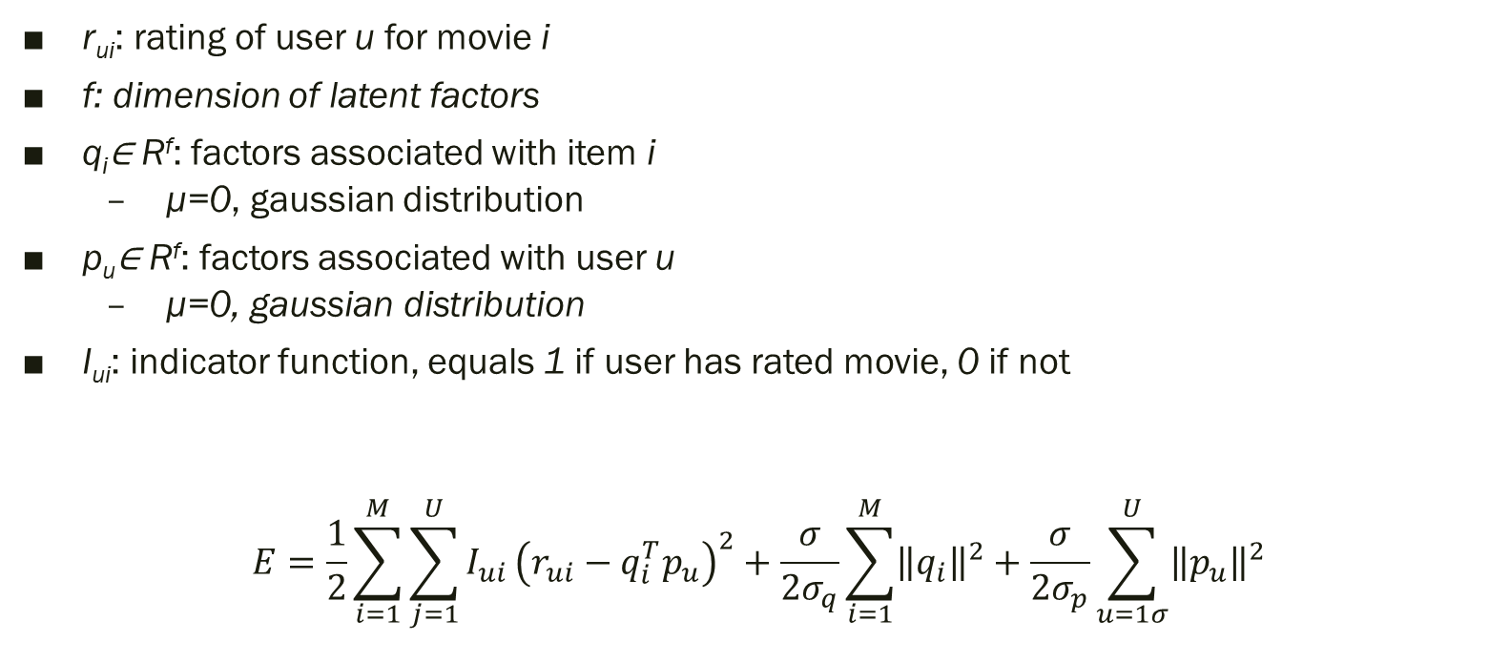
PMF calculation
r_{ui}: rating of user u for movie i
f: dimension of latent factors
q_{i}∈ R^{f}: factors associated with item i
µ=0, gaussian distribution
p_{u}∈ R^{f}: factors associated with user u
µ=0, gaussian distribution
I_{ui}: indicator function, equals 1 if user has rated movie, 0 if not
$$E=\frac{1}{2}\sum_{i=1}^{M}{\sum_{j=1}^{U}{I_{ui}}}{\left(r_{ui}−q_{i}^{T}p_{u}\right)}^{2}+\frac{σ}{2σ_{q}}\sum_{i=1}^{M}{{\left\|q_{i}\right\|}^{2}}+\frac{σ}{2σ_{p}}\sum_{u=1σ}^{U}{{\left\|p_{u}\right\|}^{2}}$$

Slide 5
PMF Parameter Tuning

Slide 6
Large-scale Parallel Collaborative Filtering (LPCF)
A parallel algorithm that alternates least-squares with weighted λ-regularization
Refined using kNN
Achieves good results without date or movie title information
Parallel computing keeps this method fast and efficient
Uses a regularization term to effectively remove overfitting by penalizing large parameters
Benefits:
Scalable with large, sparse data
Original study found a 5.91% improvement over Netflix’s algorithm

Slide 7
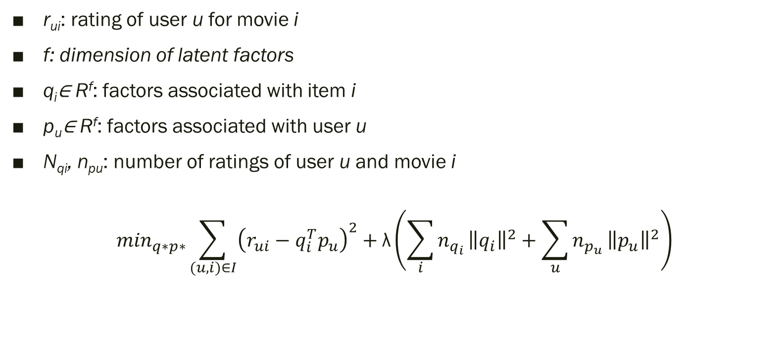
LPCF calculation
r_{ui}: rating of user u for movie i
f: dimension of latent factors
q_{i}∈ R^{f}: factors associated with item i
p_{u}∈ R^{f}: factors associated with user u
N_{qi}, n_{pu}: number of ratings of user u and movie i
$$\min_{q∗p∗}\sum_{(u,i)∈I}{{\left(r_{ui}−q_{i}^{T}p_{u}\right)}^{2}}+\text{λ}\left({\sum_{i}{n_{q_{i}}}\left\|q_{i}\right\|}^{2}+\sum_{u}{n_{p_{u}}}{\left\|p_{u}\right\|}^{2}\right)$$

Slide 8
LPCF Parameter Tuning

Slide 9
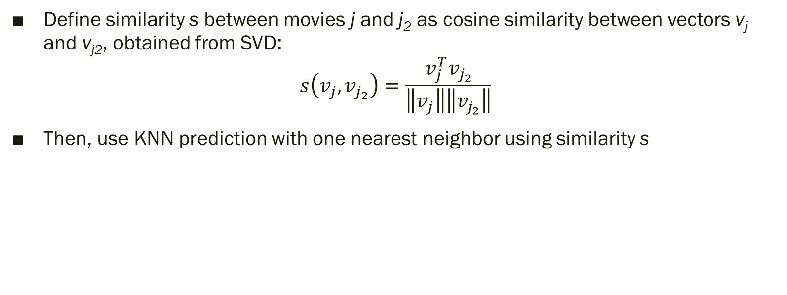
Postprocessing: SVD with KNN
Define similarity s between movies j and j₂ as cosine similarity between vectors v_{j} and v_{j2}, obtained from SVD:
$$s\left(v_{j},v_{j_{2}}\right)=\frac{v_{j}^{T}v_{j_{2}}}{\left\|v_{j}\right\|\left\|v_{j_{2}}\right\|}$$
Then, use KNN prediction with one nearest neighbor using similarity s

Slide 10
Evaluation and Results

Slide 11
Thank you

